Slide 1
OACC Data Summit: Labor Market Information’s Data Hub
Chris Dixon, Assistant Bureau Chief
Ohio Bureau of Labor Market Information
July 23, 2026

Slide 2
Who are we?
Produce Labor Market Data
LMI helps Ohio make informed economic decisions
Ohiolmi.com
Disseminate information
and data tools
Conduct research and data analysis
Help analyze and interpret data

Slide 3
LMI Programs
QCEW Quarterly Census of Employment and Wages
OEWS Occupational Employment and Wage Statistics
CES Current Employment Statistics
LAUS Local Area Unemployment Statistics
Employment Projections
Job Ad Analytics

Slide 4
LMI Programs
QCEW Quarterly Census of Employment and Wages
Description
Tools
  Employment and wage data
  By industry
  For Ohio, MSAs, and counties
  Quarterly releases
  QCEW Home
  QCEW Data Search Tool
Data Uses
  Employment trends
  Wage levels
  Industry growth

Slide 5
LMI Programs
OEWS Occupational Employment and Wage Statistics
Description
Tools
  Employment and wage estimates
  By occupation
  For Ohio, MSAs, JobsOhio regions, and Workforce Areas
  Annual releases
  OEWS Home
  OEWS Data Search Tool
Data Uses
  Employment levels
  Wage comparison
  Occupational concentrations

Slide 6
LMI Programs
CES Current Employment Statistics
Description
Description
Tools
Tools
  Employment, hours, and earnings
  By industry
  For Ohio and MSAs
  Monthly releases
  Employment, hours, and earnings
  By industry
  By MSA
  Monthly releases
  CES Home
  CES Data Search Tool
  Labor Market Review
  CES Dashboard
Data Uses
Data Uses
  Employment trends
  Industry growth
  Employment trends
  Industry growth

Slide 7
LMI Programs
LAUS Local Area Unemployment Statistics
Description
Tools
  Unemployment rates
  For Ohio, MSAs, counties, and cities with at least 25,000 people
  Monthly releases
  LAUS Home
  LAUS Data Search Tool
  Labor Force Statistics Dashboard
Data Uses
  Unemployment trends
  Workforce development needs
  Geographic trends

Slide 8
LMI Programs
Employment Projections
Description
Tools
  2- and 10-year employment projections
  By industry and occupation
  For Ohio, JobsOhio regions, and select MSAs
  Annual releases
  Projections Home
  Occupational Projections Data Search Tool
  Industry Projections Data Search Tool
Data Uses
  Workforce development planning
  Education planning
  Training program planning

Slide 9
LMI Programs
Job Ad Analytics
Description
Tools
  Online job postings
  By occupation
  For Ohio, JobsOhio regions, and counties
  Monthly releases
  Job Postings Home
Data Uses
  Occupational demand trends
  Skills analysis
  Regional demand

Slide 10
LMI Programs
QCEW Quarterly Census of Employment and Wages
OEWS Occupational Employment and Wage Statistics
CES Current Employment Statistics
LAUS Local Area Unemployment Statistics
Employment Projections
Job Ad Analytics

Slide 11
LMI Data
Accessibility Challenges
Datasets are large and detailed
Requires prior familiarity to interpret effectively
Differences in geography, timelines, and methodologies across datasets

Slide 12
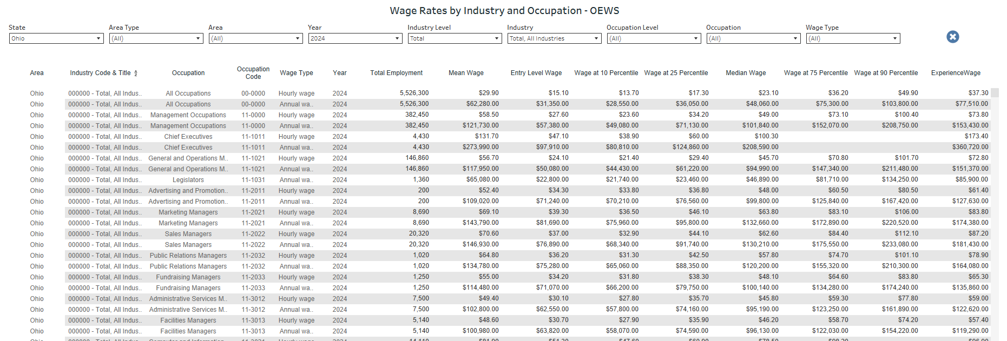
LMI Data

Slide 13
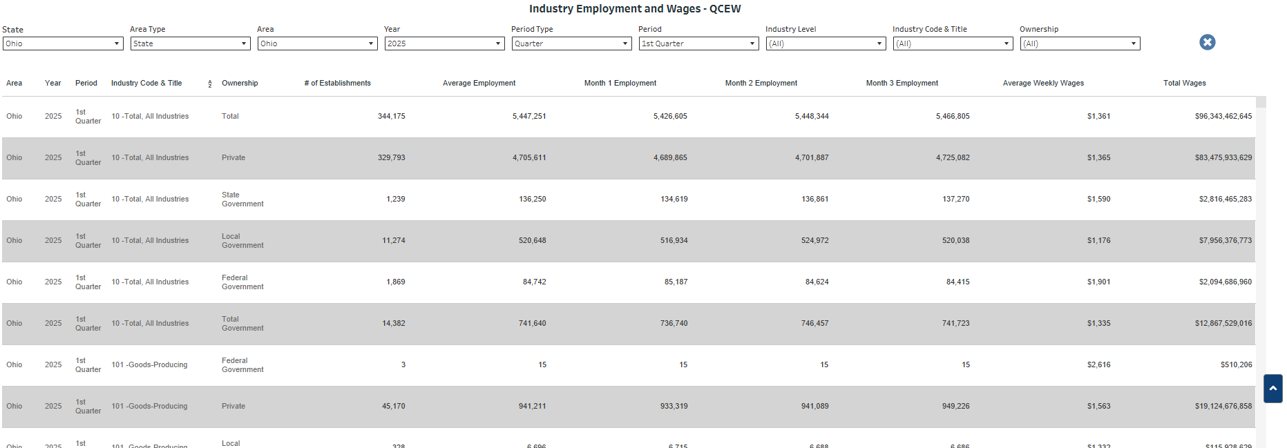
LMI Data

Slide 14
The Data Hub
Accessibility Challenges
Datasets are large and detailed
Requires prior familiarity to interpret effectively
Differences in geography, timelines, and methodologies across datasets
Data Hub Goals
Improve accessibility
Consolidate information
Provide localized data
Curate data elements
Develop printable reports

Slide 15
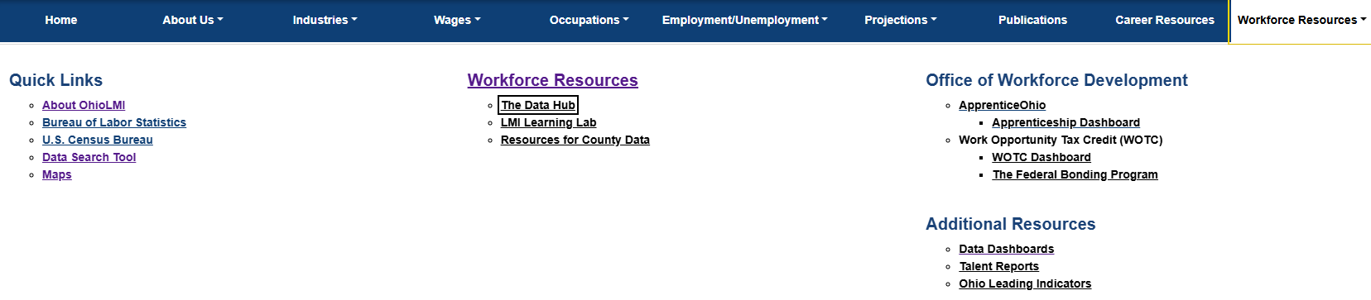
The Data Hub
How do I find the Data Hub?
Go to Ohiolmi.com
Select Workforce Resources from the Navigation bar
Select The Data Hub

Slide 16
Connect with Us
Website
OhioLMI.com
Email
ContactLMI@jfs.ohio.gov
Call
(614) 752-9494
LMI Learning Lab
Registration Page

